Slide 1
CSE 405
I/O Interfacing
Osama Hosameldeen
Spring 2021
Lecture 2: Data Acquisition on the PC

Slide 2
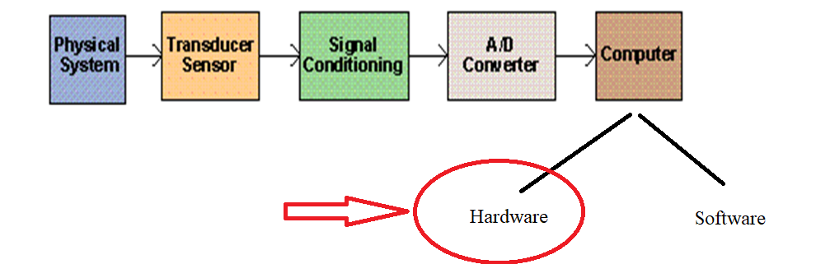
Contents
The PC as a platform for data acquisition
The 80x86 family of processors
Processor components
Memory
Input/Output
© 2015 ELSIVER, All rights reserved. compiled by Dr. Osama Hosameldeen

Slide 3
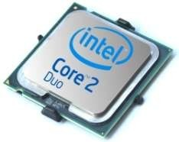
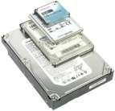
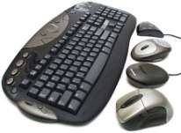
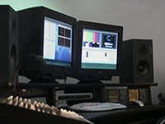
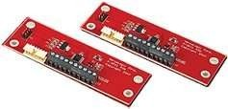


Von Neumann model
CPU
Memory
Input
Output
Data Bus
Control Bus
Address Bus
Von Neumann model of computer architecture

Slide 4
The PC as a platform for data
acquisition
© 2015 ELSIVER, All rights reserved. compiled by Dr. Osama Hosameldeen

Slide 5
The PC as a platform for data acquisition
PC involves reading electrical signals into a computer from some form of sensor.
Often the data is analyzed or processed in some way in order to generate further signals for controlling external equipment or for interfacing to other computers.
For example, at sunset, the light sensor is sending signal to PC, the PC sends contorl signal to the electrical light system to turn lights on.
© 2015 ELSIVER, All rights reserved. compiled by Dr. Osama Hosameldeen

Slide 6
The PC as a platform for data acquisition
The IBM PC was originally developed as a stand-alone machine for office desktop use.
Many systems are built into rack-mounted chassis. They may incorporate conventional motherboard designs or they may utilize a backplane system into which a processor card, video adaptors and disk drive controllers are inserted
Both hard disks and floppy disk drives tend to be easily damaged by dust, These problems are circumvented in some systems by substituting a solid state (i.e. EPROM or SRAM based) disk emulation card.

Slide 7
The PC as a platform for data acquisition
Single-board computers are often integrated into dedicated equipment which is used, for example, in industrial or medical monitoring applications.
These embedded systems are normally designed so as to minimize size, power consumption and cooling requirements
Embedded PC controllers are also used in mobile equipment.
These can easily interface to external data logging or control equipment in order to facilitate configuration or downloading of acquired data

Slide 8
The 80x86 family of processors
© 2015 ELSIVER, All rights reserved. compiled by Dr. Osama Hosameldeen

Slide 9
The 80x86 family of processors
Some specialized systems (particularly embedded PC applications) still make use of the earlier 8086, 80286 and 80386 processors.
The 80186, for example, is similar to the 8086, but also possesses on-chip DMA (Direct Memory Access) and interrupt controllers
From the viewpoint of application-software development
  real-mode processors (8088, 8086 and compatibles such as the NEC V20 and V30);
  the intermediate 80286 processor; and
  full 32-bit processors (80386, 80486, Pentiums and Celeron processors).

Slide 10
The 80x86 family of processors
Real-mode: The 8086 directly addressing up to 1 MB of memory. support the execution of only one program (or process) at any time. This process has complete control over the PC and has direct access to all addressable memory and I/O locations. No protection for safe multi-tasking.
The protected mode available on 80286 and later processors helps to circumvent the 1 MB limitation. As well as providing access to more memory, it incorporates a number of mechanisms (such as Virtual machine) which help to prevent processes from conflicting with each other or with the operating system.

Slide 11
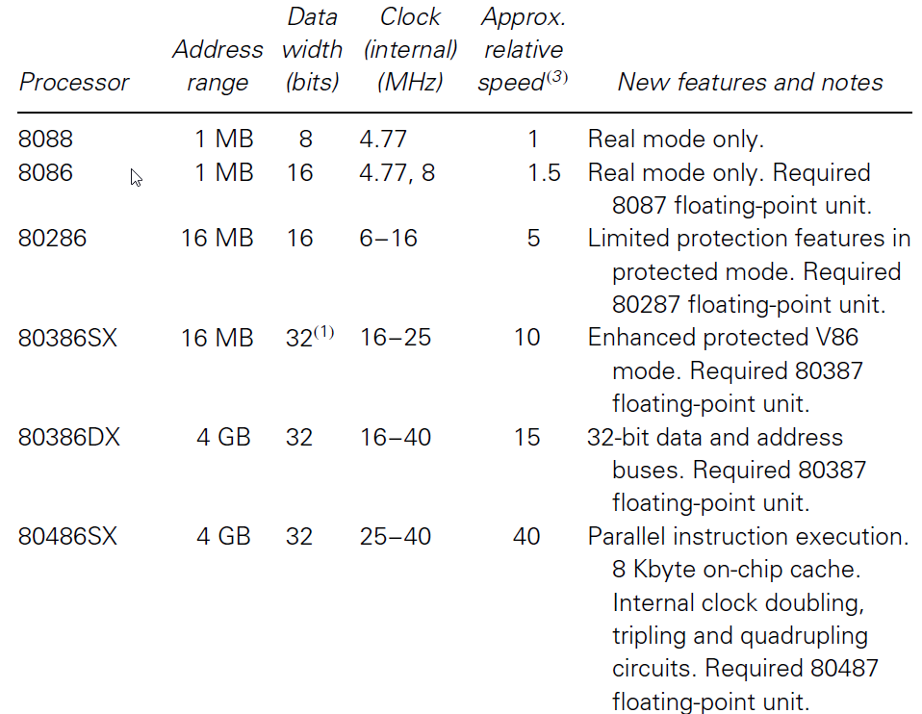
The 80x86 family of processors

Slide 12
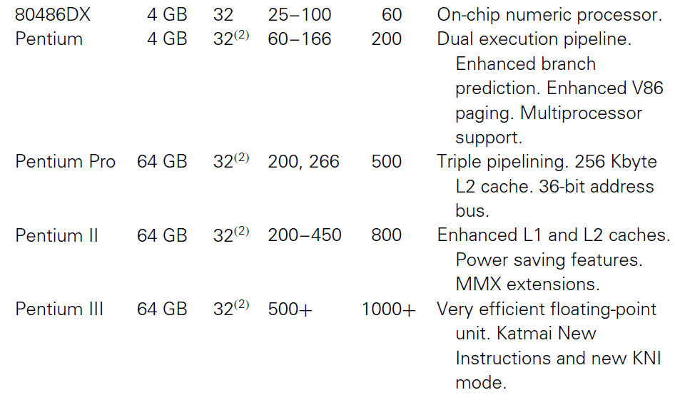
The 80x86 family of processors

Slide 13
The 80x86 family of processors
In essence the early real-mode ran only one program at a time, provided limited memory addressing (up to 1 MB), and operated relatively slowly
At the other extreme, the 80486DX and Pentium class processors can address large amounts of memory (4 GB), and possess features for task switching, high speed processing and memory/hardware protection. These capabilities are used by sophisticated 32-bit operating systems such as Windows NT to implement efficient multitasking and to control access to system resources.
© 2015 ELSIVER, All rights reserved. compiled by Dr. Osama Hosameldeen

Slide 14
The 80x86 family of processors
Pentium II processors operate at up to 450 MHz internally. This and enhancements such as 64-bit external data bus, separate caches for instructions and data.
The Pentium III offers further improvements in performance. Initial versions are clocked at up to 500 MHz. Enhancement in the floating-point processing.
‘backward compatible’. Software written for an 80286 processor, for example, will generally be able to run on 80386 and all later processors.
© 2015 ELSIVER, All rights reserved. compiled by Dr. Osama Hosameldeen

Slide 15
Processors
© 2015 ELSIVER, All rights reserved. compiled by Dr. Osama Hosameldeen

Slide 16
Processors: Registers
Each processor in the 80x86 family possesses several 16-bit registers which are used to hold data and memory addresses.
Registers, such as CS, DS and SS, address particular memory segments
Others (e.g. IP,SP, BX) address individual bytes or words as offsets from segment beginning.
Some of the 16-bit registers (i.e. AX, BX, CX and DX) allow their high and low order bytes to be addressed separately, For example, the high order byte of AX is referenced within an assembly language program as AH, and the low order byte as AL.
Notes:
code segment (CS), the current data segment (DS), the current stack segment (SS)
BX is usually called base register, SP is stack pointer, and IP is instruction pointer
AX is usually called accumulator register, CX is commonly called counter register, DX register is the data register

Slide 17
Processors: Numeric Processing
Predecessors of the 80486DX have a limited mathematical processing capability, they don’t have floating-point processing. The solution can be:
  Processing Software: Not suitable for high-speed applications specially those need much mathematical processing such as PID controllers.
  Numeric processing unit: The 80486DX and Pentium class processors have built-in numeric processing units
  External processing unit: Attached to the peripheral, numeric processing are executed only during the period of data acquisition.

Slide 18
Memory
© 2015 ELSIVER, All rights reserved. compiled by Dr. Osama Hosameldeen

Slide 19
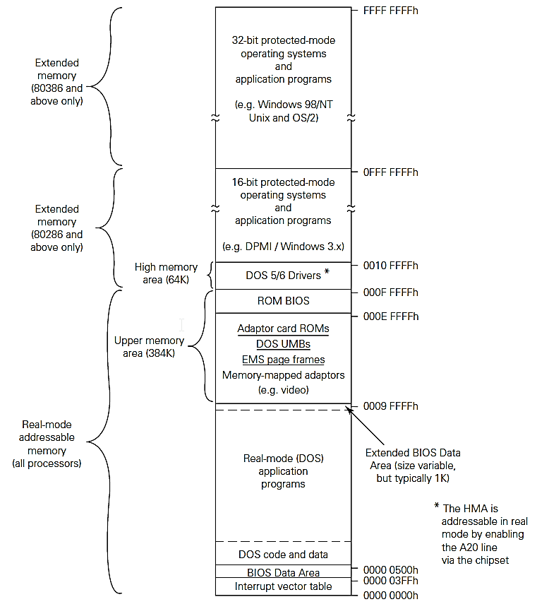
Memory

Slide 20
Memory: Paged Virtual Memory
Physical
Memory
Conceptually break up both logical (virtual) memory and physical memory into equal sized blocks
Need mechanism to translate from logical pages to physical frames
LOW
12
Page Table
User’s view
Page 0
35
15
Page 1
52
Page 2
12
Page 3
15
35
52
HIGH

Slide 21
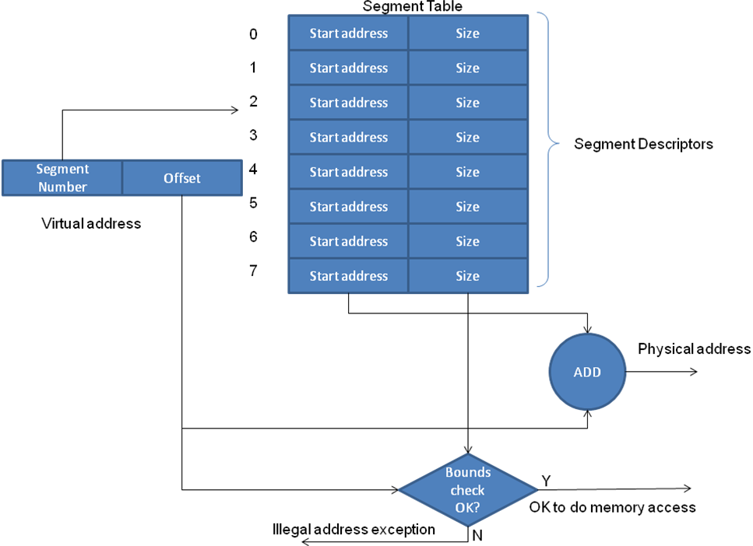
Memory:
Segmented Virtual Memory
Process address space divided up into n distinct segments
Each segment has
  A number
  A size
Each segment starts at its own address 0 and goes up to its size

Slide 22
Input/Output
© 2015 ELSIVER, All rights reserved. compiled by Dr. Osama Hosameldeen

Slide 23
I/O: Input/output ports
In addition to its memory, the PC has separate address space. Used to transfer data to or from peripheral devices know as I/O space.
Each port is addressable in much the same way as memory, although an additional control line is used within the PC to distinguish between memory and I/O port accesses.
Unlike memory space, the I/O address space is not segmented and cannot be paged. In fact, the processor references I/O ports by means of a 16-bit address and this means that no more than 65,536 I/O ports can be supported by the PC.
© 2015 ELSIVER, All rights reserved. compiled by Dr. Osama Hosameldeen

Slide 24
I/O: I/O port allocation
Specific combination of address and control lines is needed to cause data to be transferred from the register to the PC’s data bus or vice versa.
Whether ports are read-only (R/O), write-only (W/O) or read-write (R/W) is determined by how the hardware decodes the address and control lines.
The processor itself makes no distinction between ports in this regard.
© 2015 ELSIVER, All rights reserved. compiled by Dr. Osama Hosameldeen

Slide 25
I/O: I/O protection mechanisms
I/O access is restricted in the protected mode, that’s important for multitasking operating systems such as OS/2 and Windows NT to control which processes will be allowed to read and write the I/O ports.
It is possible for OS to mediate between two or more processes that need to access the same I/O device.
The operating system runs at a high privilege level, and can execute certain privileged instructions, such as those access the I/O ports and those which change the state of the processor’s Interrupt Flag
© 2015 ELSIVER, All rights reserved. compiled by Dr. Osama Hosameldeen

Slide 26
Buses
© 2015 ELSIVER, All rights reserved. compiled by Dr. Osama Hosameldeen

Slide 27
Buses: Buses and adaptor card slots
The microprocessor can be interfaced with the peripherals via several techniques, they are:
Memory space interface
I/O ports interface such as serial and parallel ports
Direct/internal bus interface using internal buses such as ISA, EISA, PCI, AGP, USB, SATA, IDE, SCSI, …
Indirect/external bus interface using external buses such as GPIB, CAMAC, CAN, etc.
Motherboard
Microprocessor
Internal Bus
External Bus
Peripheral
Indirect bus interface
Peripheral
Direct bus interface

Slide 28
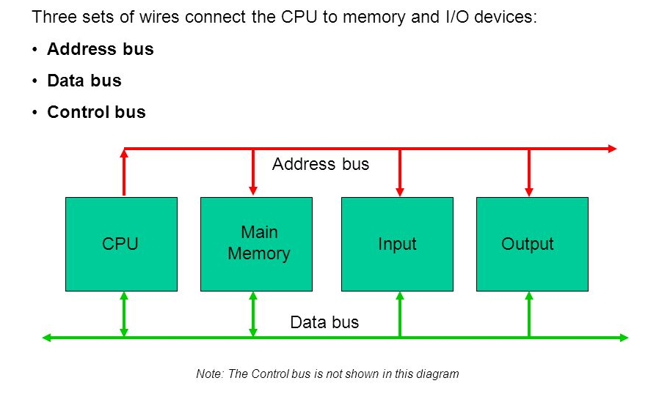
Memory space interface buses
© 2015 ELSIVER, All rights reserved. compiled by Dr. Osama Hosameldeen

Slide 29
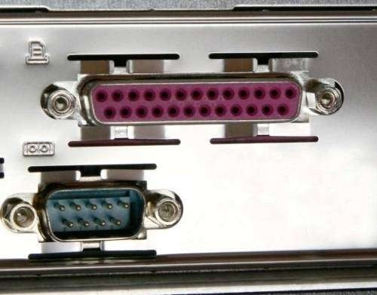
I/O Ports
To interface two peripherals one of them is parallel and the second is serial
We have to use parallelizing and serializing stages to connect both of them.
The parallelizing stage converts the serial pulses into parallel data
While the serializing stage converts the parallel data into serial pulses.
Serial
Parallelizing
Parallel
Serializing
Parallel Serial Interface

Slide 30
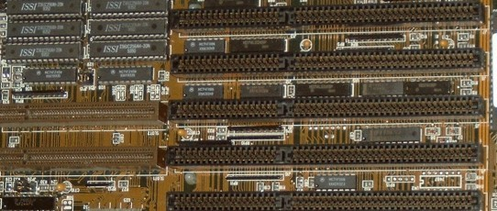
ISA Bus
Introduced by IBM, ISA or Industry Standard Architecture was originally an 8- bit bus that was later expanded to a 16-bit bus in 1984.
When this BUS was originally released it was a proprietary BUS, which allowed only IBM to create peripherals and the actual interface.
However, in the early 1980's other manufacturers were creating the bus.
ISA Bus
DMA technique used on the ISA bus

Slide 31
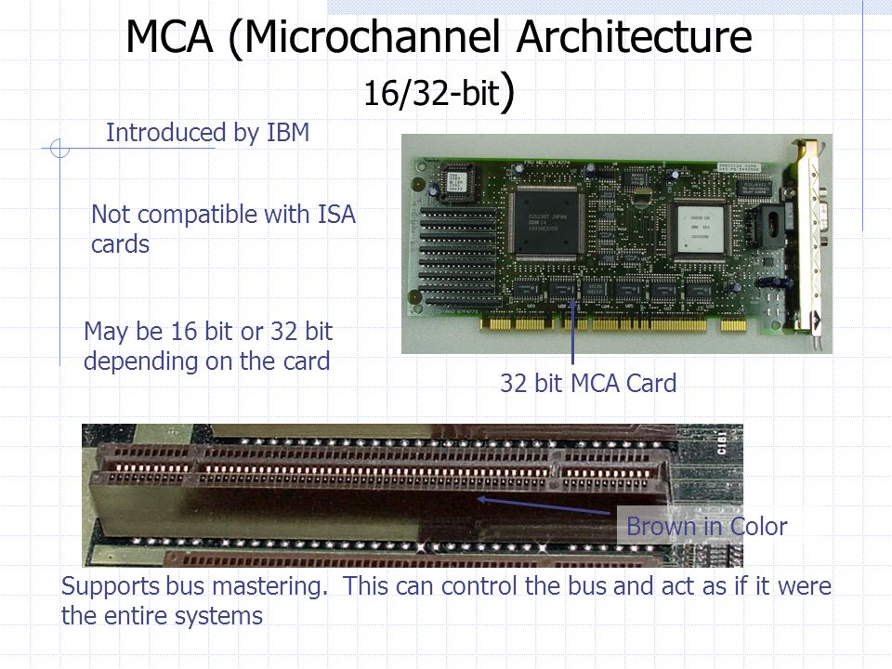
MCA Bus

Slide 32
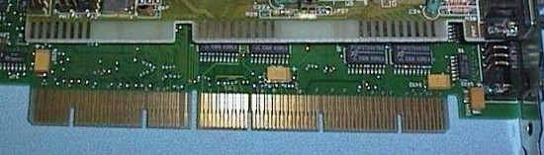
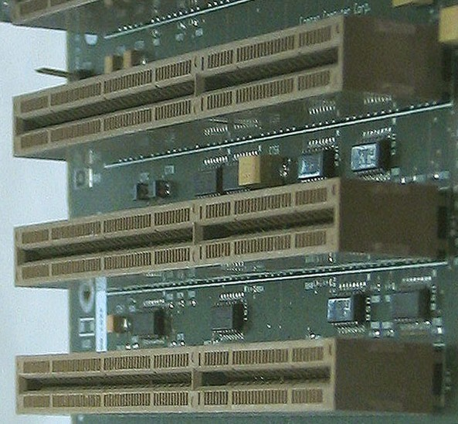
EISA BUS
Short for Extended Industry Standard Architecture, EISA was announced September of 1988. EISA is a computer bus designed by 9 competitors to compete with IBM's MCA BUS
The EISA Bus provided 32-bit slots at an 8.33 MHz cycle rate. In addition, the EISA can accommodate a 16-bit ISA card in the first row.
Unfortunately, while the EISA bus is backwards compatible and is not a proprietary bus the EISA bus never became widely used and is no longer found in computers today.
The EISA Bus

Slide 33
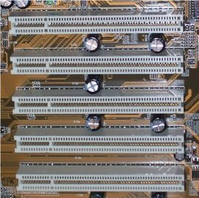
PCI BUS
It is a kind of local buses which are more tightly coupled to the processor. Because of its locality, it provides a high-speed transmission rate (processor’s clock rate).
PCI is short for Peripheral Component Interconnect and is a 32-bit computer bus that is also available as a 64-bit bus today. The PCI bus is the most commonly used and found bus in computers today.
The PCI bus also supports bus mastering in
which PCI devices can take control of the bus
in order to transfer data. This is much like the
DMA technique used on the ISA bus The principal
difference is that each device supplies
its own bus-mastering hardware rather
than relying on the PC’s DMA controller
The PCI bus version 2.1

Slide 34
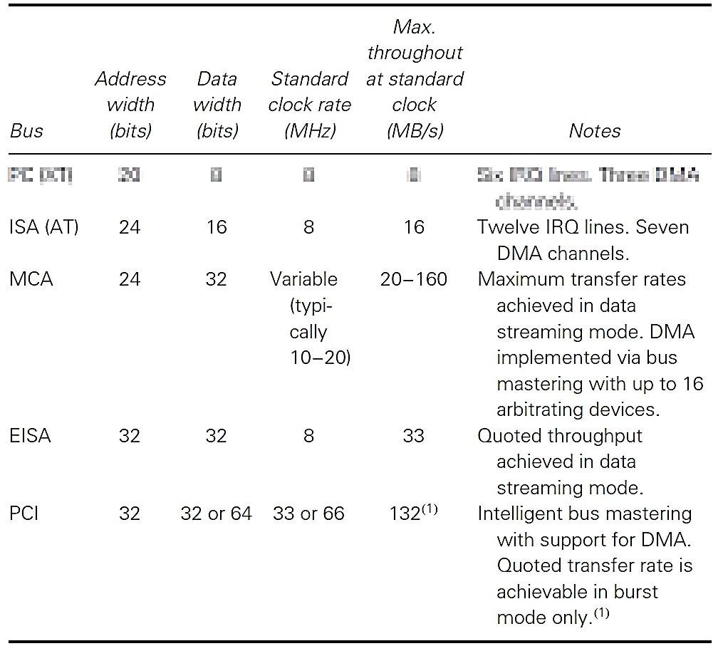
Transfer rates
© 2015 ELSIVER, All rights reserved. compiled by Dr. Osama Hosameldeen

Slide 35
Factors that delay speed
In practice, delays inherent in other components (e.g. the ADC conversion time, multiplexer settling times, signal conditioning bandwidth) tend to be the principal throughput-limiting factors.
For this reason, the maximum bus transfer rate cannot usually be realized and in many applications bus speed has only a minimal effect on the overall system throughput.
© 2015 ELSIVER, All rights reserved. compiled by Dr. Osama Hosameldeen

Slide 36
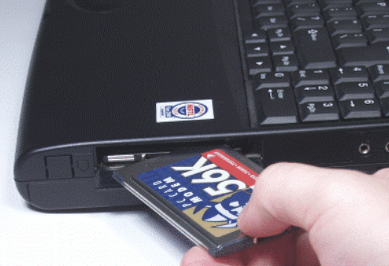
PCMCIA interface
PCMCIA cards (sometimes known as just PC cards) are a fairly recent innovation in PC interfacing.
The PCMCIA (Personal Computer Memory Card International Association) standard defines a hardware and software interface for attaching miniature adaptor cards to the PC.
© 2015 ELSIVER, All rights reserved. compiled by Dr. Osama Hosameldeen

Slide 37
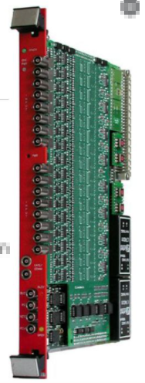
Industrial and instrumentation buses
There are three main types of buses: STE/STD, Multibus and VME.
STE/STD : is an 8-bit bus capable of addressing 1 MB of memory and 4 KB of I/O space
Multibus: also permits access to a 1 MB memory space but allows 16-bit data transfers. Its successor, Multibus II, provides an enhanced addressing capability and is suitable for use with 32-bit processors
VME: The VME bus has been widely used in embedded systems for some years. It is capable of 8-, 16-, 32- or 64-bit data transfers
VME
© 2015 ELSIVER, All rights reserved. compiled by Dr. Osama Hosameldeen

Slide 38
Other buses
IEEE-488
Centronics parallel port
serial buses such as RS-232, RS-422, RS-485 and USB
Transfer systems and protocols, such as HART (Highway Addressable Remote Transfer) and BitBus
© 2015 ELSIVER, All rights reserved. compiled by Dr. Osama Hosameldeen

Slide 39
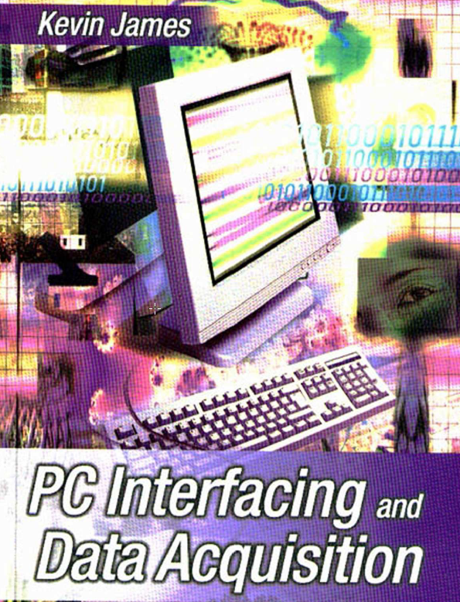
Reference
Kevin James - PC Interfacing and Data Acquisition Techniques for Measurement, Instrumentation and Control. (2000)
Chapter 1
© 2015 ELSIVER, All rights reserved. compiled by Dr. Osama Hosameldeen

